Slide 1
CAD to ROS Workbench
URDF Editor Workgroup Meeting
22 Feb., 2016

Slide 2
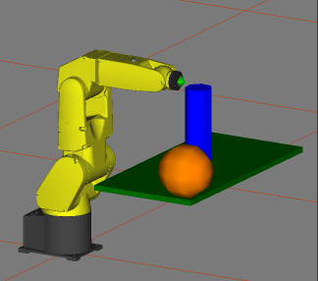
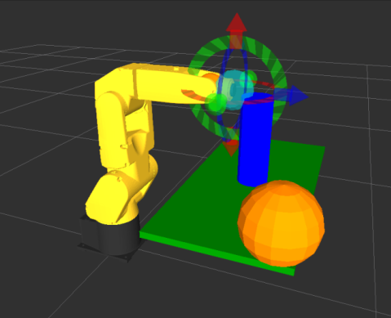
Need for CAD to ROS
ROS work cell setup:
RViz, TF, IK: URDF, xacros, macro.xacros
Cartesian paths: CSV, Apt, STEP-NC
MoveIt!: SRDF
Industrial Calibration: YAML
PCL: Point cloud simplification, registration, manual edits

Slide 3
CAD to ROS Workbench
3D Front End for Robot Work Cell Setup
Milestone 1: URDF GUI Editor
Milestone 2: Process Planning
Milestone 3: Motion Planning
Milestone 4: Sensor Configuration and Calibration Setup
Milestone 5: 3D Point Cloud Importer

Slide 4
URDF Editor: Status
[Done -URDFs] Open and edit new or existing URDFs and xacros
Add an existing URDF or xacro to a second URDF or xacro
Add/modify parent-child relationships in a tree structure with GUI controls
Add/modify tool flange and tool center point (TCP) locations
[Done] Edit link and joint properties with GUI controls
[Done] Display changed properties instantly in RViz (no need to reload RViz from the command line)
[Need to add STEP] Import/add STL, Collada, and STEP for individual parts (assemblies will treated as a single part for this milestone)
Create collision geometry (i.e. convex hulls) for individual part files
Hide/display geometry and origins

Slide 5
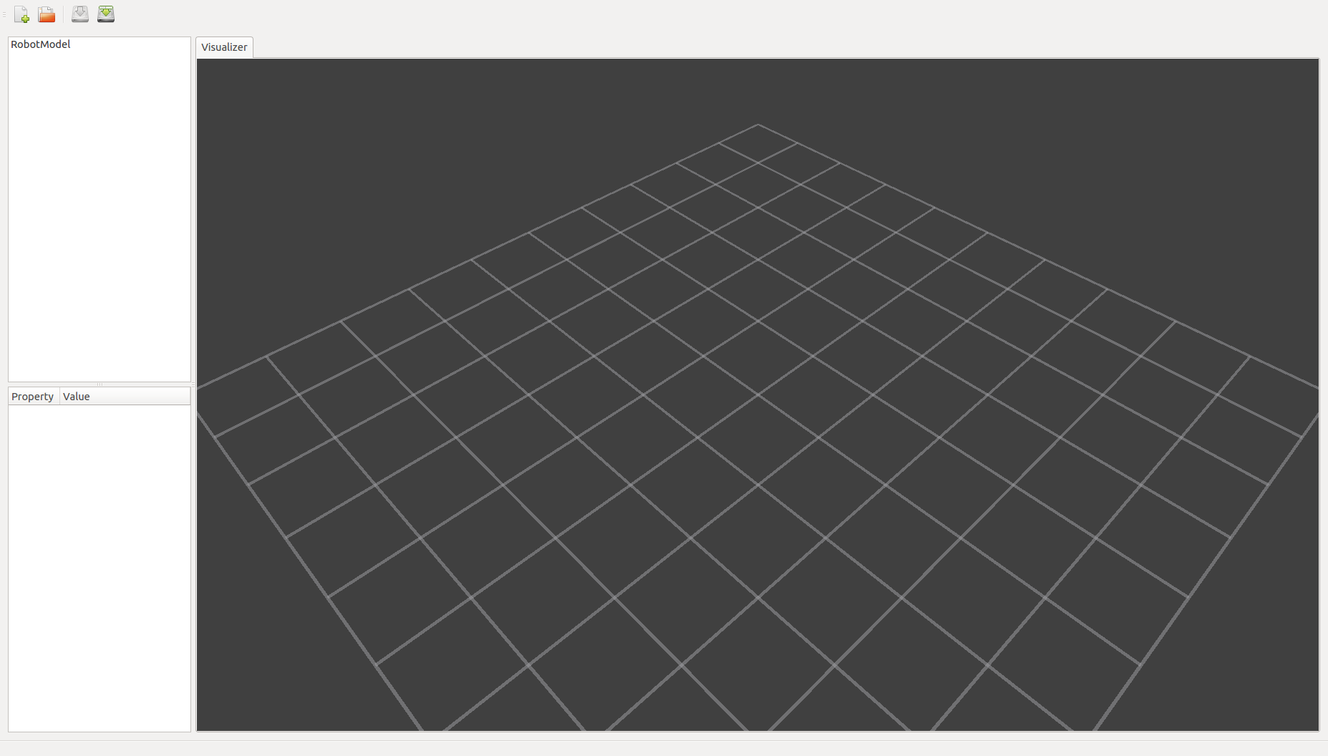
URDF Editor: Status
Empty Workspace

Slide 6
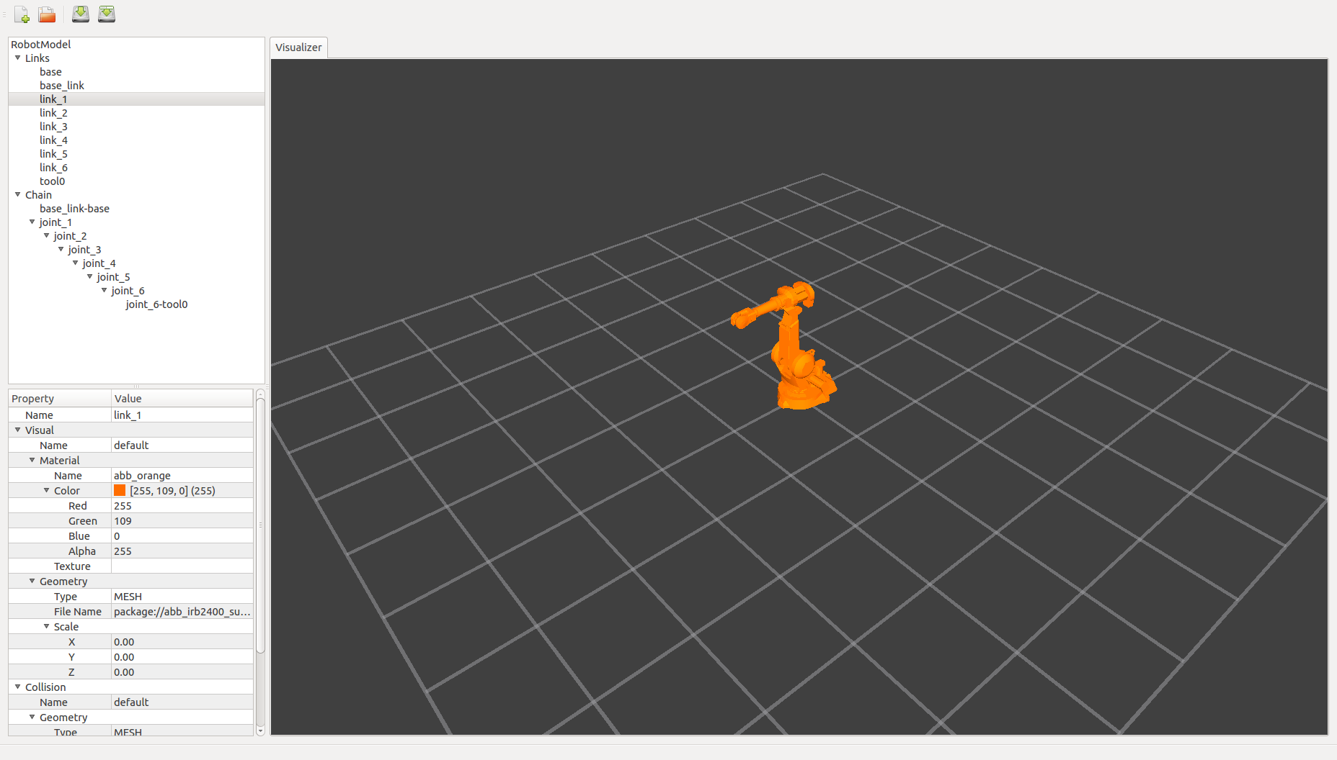
URDF Editor: Status Continued
URDF Loaded

Slide 7
Programmatics
GitHub
https://github.com/orgs/ros-industrial-consortium/teams/cad-to-ros
Repo is private
Contributors
Sponsor: Boeing
Technical Overseer: Gijs van der Hoorn, TU Delft
Documents architecture via GitHub issues
Reviews pull requests
Developers: RIC Members
One pull-request per month
Access to the private repo
RIC Administrators: Paul and Mirko
Recruit developers

Slide 8
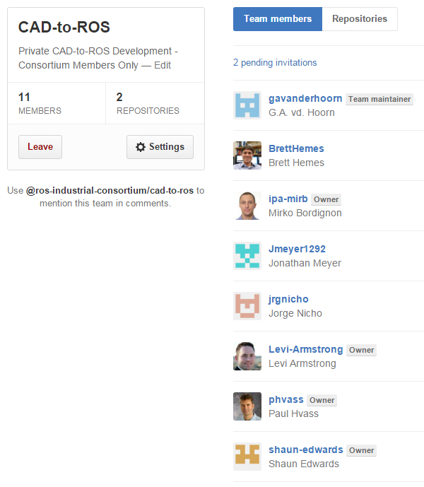
Team

Slide 9
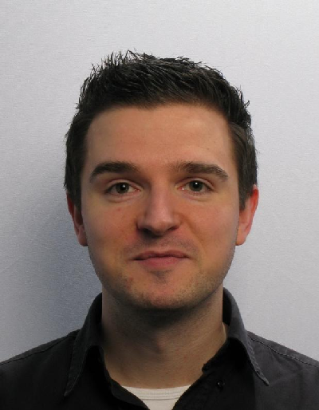
Technical Lead
Gijs van der Hoorn, MSc
Researcher
Delft Robotics Institute
Delft University of Technology
the Netherlands
GitHub : gavanderhoorn Email : g.a.vanderhoorn@tudelft.nl
robotics.tudelft.nl
Gijs van der Hoorn is a full time researcher at the Delft Robotics Institute and the Delft BioRobotics Laboratory of the Technical University of Delft in the Netherlands. His main interests include software engineering in experimental robotics contexts, industrial robotics and factory automation. Gijs received his Master of Science in Computer Science from the Technical University of Delft.

Slide 10
Schedule
4 month period of performance
PO issued Dec. 11
Contract Deadline: April 11
Due to holidays, can we extend to May 1 ?

Slide 11
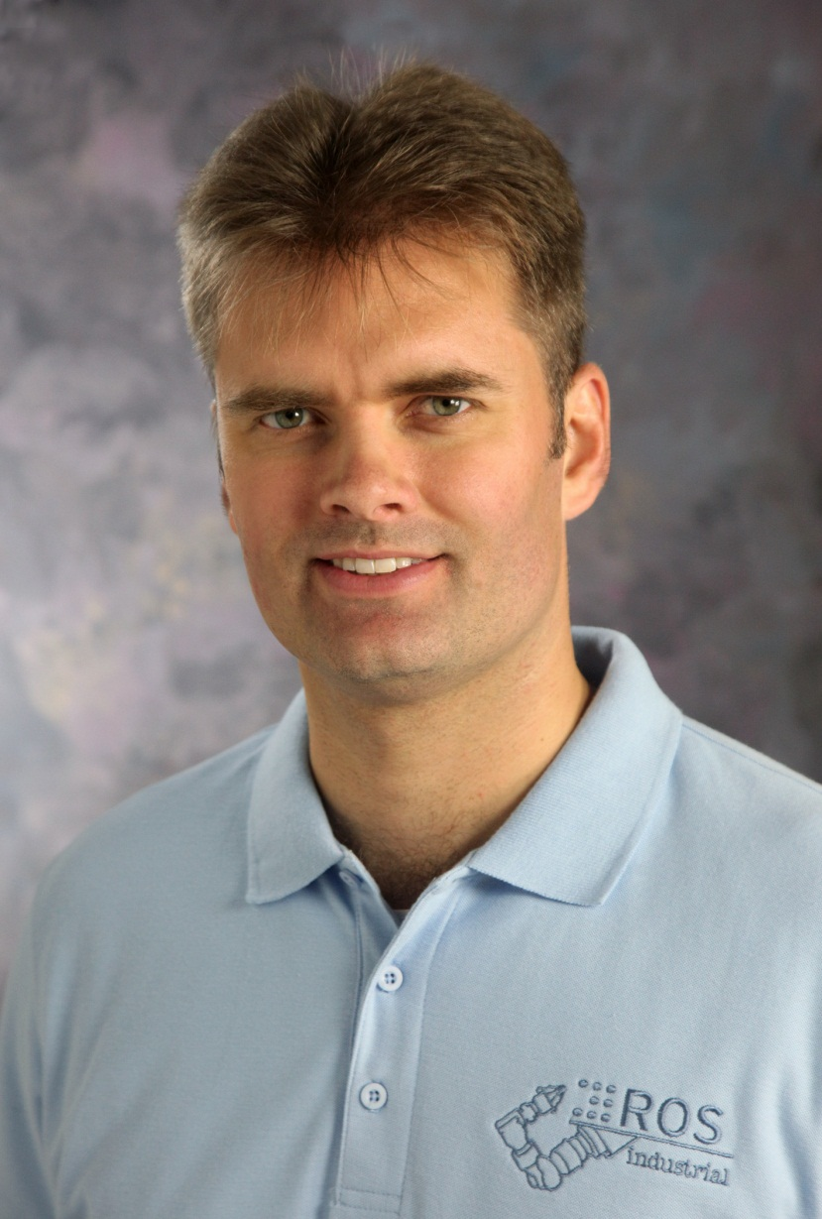
Contact Information
Paul Hvass
ROS-I Consortium Program Manager
SwRI
9503 W. Commerce
San Antonio, TX 78227 USA
Phone: 210-522-5823 Email: paul.hvass@swri.org
www.ROS-Industrial.org
22 Feb. 2016

